Slide 1




GEMOC modeling crash course
---An introduction to EMF tooling ---
2017
Didier Vojtisek (Inria)
http://people.rennes.inria.fr/Didier.Vojtisek/
Didier.vojtisek@inria.fr
Benoit Combemale (Inria & Univ. Rennes 1)
http://people.irisa.fr/Benoit.Combemale
benoit.combemale@irisa.fr
@bcombemale

Slide 4
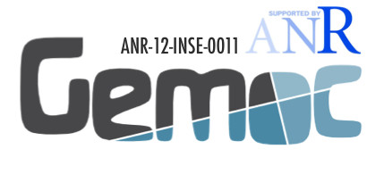
Reifying Concurrency in xDSML: Limitations
Concurrency remains implicit and ad-hoc in language design and implementation:
Design: implicitly inherited from the meta-language used
Implementation: mostly embedded in the underlying execution environment
The lack of an explicit concurrency specification in language design prevents:
leveraging the concurrency concern of a particular domain or platform
a complete understanding of the behavioral semantics
effective concurrency-aware analysis techniques
effective techniques for producing semantic variants
analysis of the deployment on parallel architectures

Slide 5
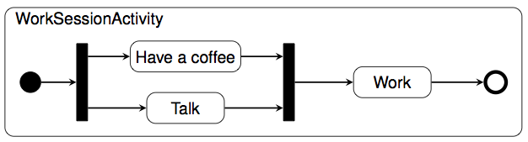
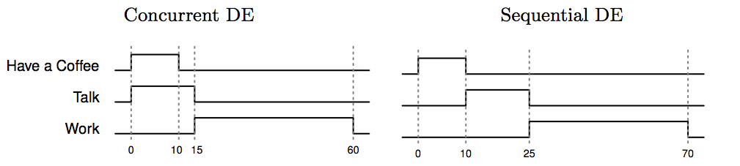
Coping with Semantic Variation Points
Florent Latombe, Xavier Crégut, Julien Deantoni, Marc Pantel, Benoit Combemale, "Coping with Semantic Variation Points in Domain-Specific Modeling Languages", In EXE@MoDELS 2015.

Slide 6
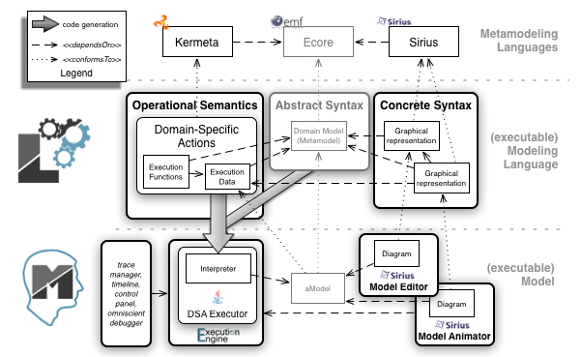
Summary of the sequential approach

Slide 7
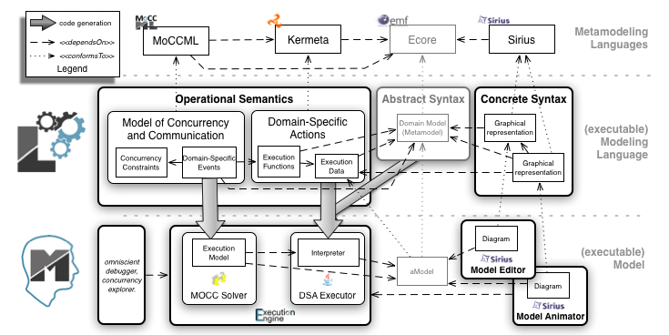
Concurrency management

Slide 8
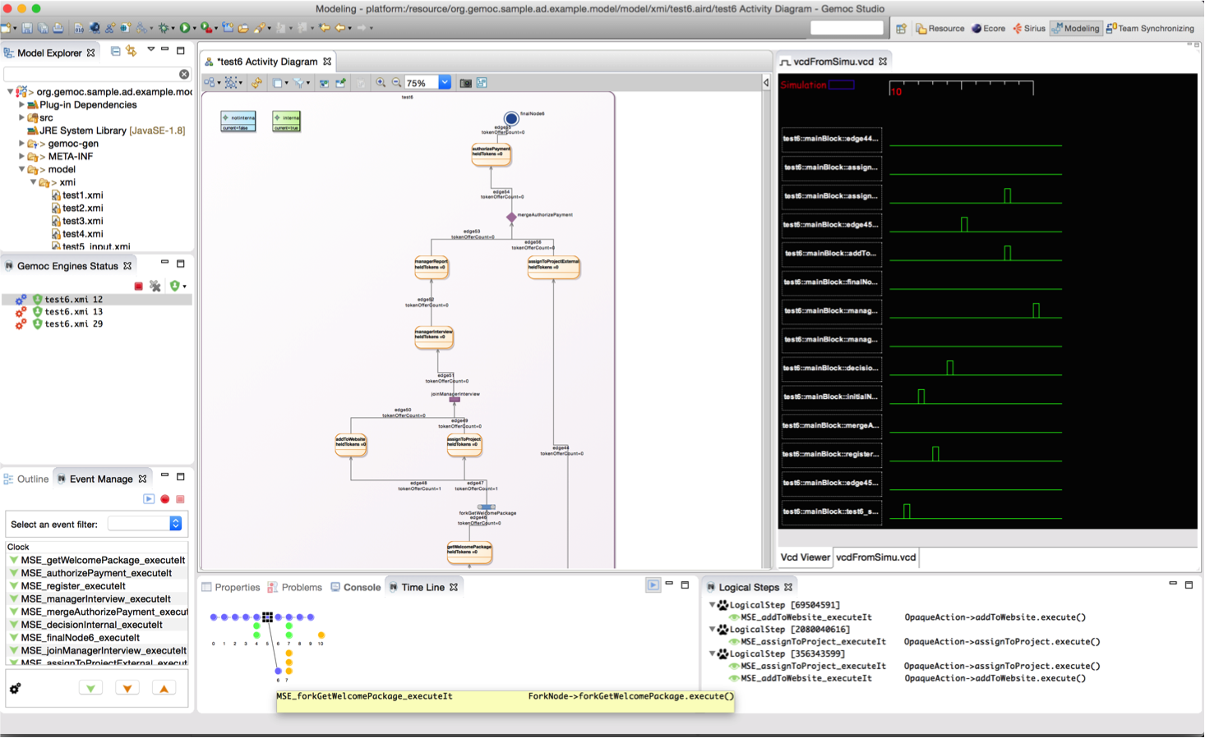
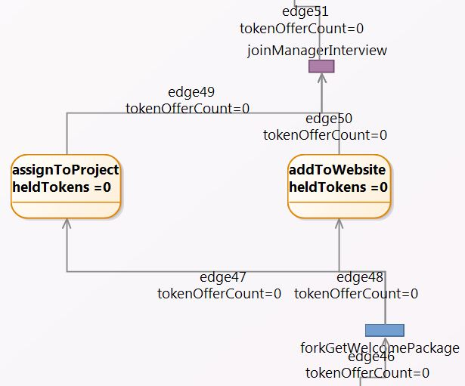
Activity Diagram Debugger
https://github.com/gemoc/activitydiagram

Slide 9
Model coordination
Once the event notion has been reified, it is then possible to reason about it.
Ie. Run several models at the same time and coordinate them

Slide 10
My 3 take away messages
#1 DSLs are important (as intuited for a long time – it will become more and more apparent)
#2 DSL technology is here (no excuse)
#3 MDE meets language engineering

Slide 11
But my take away message is NOT
That DSLs should be used systematically, in every situations

Slide 12
Worst practices
When Developing DSLs?
Tradeoff cost/time of development versus producivity gained for solving problems
If you use your DSL for resolving one problem, just one time, hum…
DSL: reusable, systematic means to resolve a specific task in a given domain
DSL development can pay off quickly
5’ you can get a DSL
But DSL development can be time-consuming and numerous worst practices exists

Slide 13
Worst practices
Worst Practices
Initial conditions
Only Gurus allowed
Believe that only gurus can build languages or that “I’m smart and don’t need help”
Lack of Domain Understanding
Insufficiently understanding the problem domain or the solution domain
Analysis paralysis
Wanting the language to be theoretically complete, with its implementation assured

Slide 14
Worst practices
Worst Practices
The source for Language Concepts
UML: New Wine in Old Wineskins
Extending a large, general-purpose modeling language
3GL Visual Programming
Duplicanting the concepts and semantics of traditional programming languages
Code: The Library is the Language
Focusing the language on the current code’s technical details
Tool: if you have a hammer
Letting the tool’s technical limitations dictate language development

Slide 15
Worst practices
Worst Practices
The resulting language
Too Generic / Too Specific
Creating a language with a few generic concepts or too many specific concepts, or a language that can create only a few models
Misplaced Emphasis
Too strongly emphasizing a particular domain feature
Sacred at Birth
Viewing the initial language version as unalterable

Slide 16
Worst practices
Worst Practices
Language Notation
Predetermined Paradigm
Choosing the wrong representational paradigm or the basis of a blinkered view
Simplistic Symbols
Using symbols that are too simple or similar or downright ugly

Slide 17
Worst practices
Worst Practices
Language Use
Ignoring the use process
Failing to consider the language’s real-life usage
No training
Assuming everyone understands the language like its creator
Pre-adoption Stagnation
Letting the language stagnate after successful adoption

